Slide 1



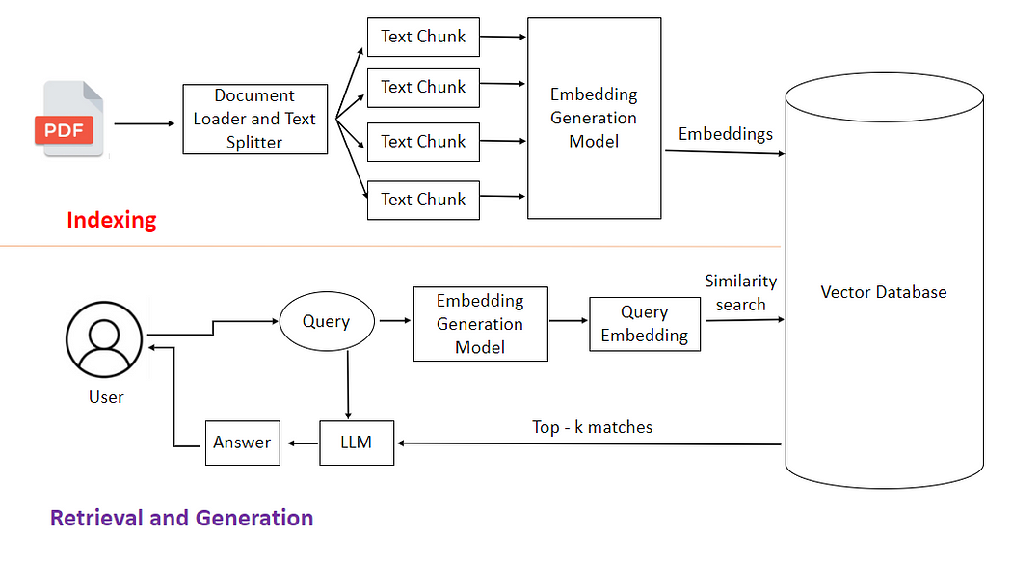

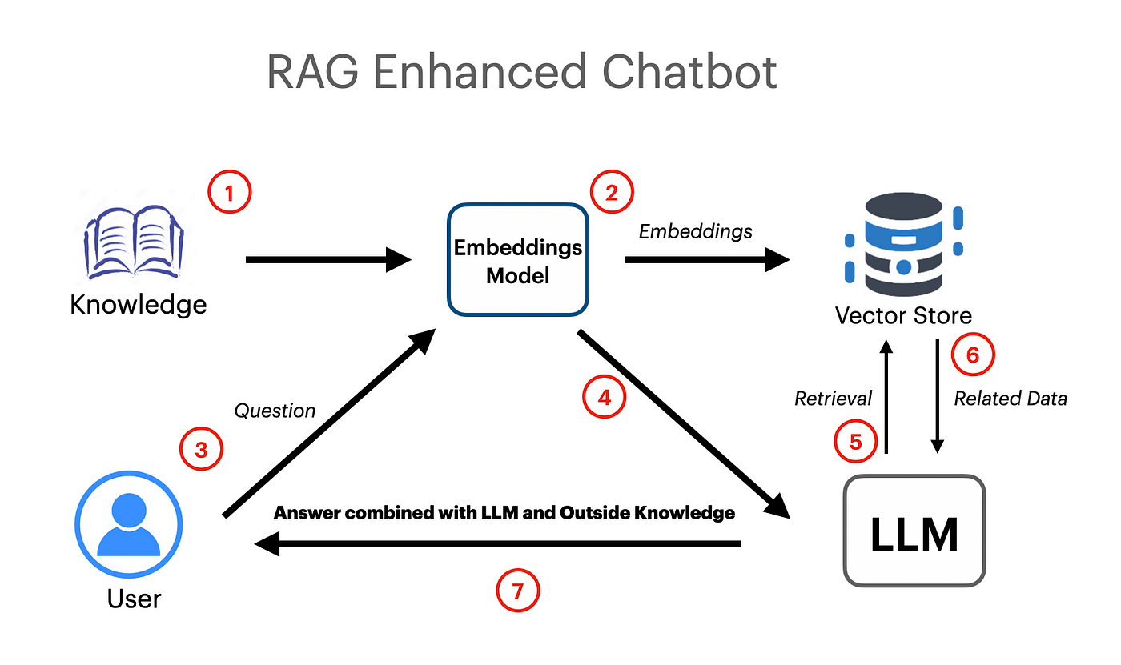
NATIONAL INSTITUTE OF TECHNOLOGY NAGALAND
An AI-Powered Health Chatbot With Personalized Recommendations
Email ID: arjun3314508@gmail.com
MOTIVATION/OBJECTIVE
METHODOLOGY
EXPERIMENTAL RESULTS
Synapse is an AI-powered health chatbot designed to revolutionize digital healthcare by leveraging Large Language Models (LLMs) with Retrieval-Augmented Generation (RAG) and vector databases. Traditional keyword-based search systems often fail to provide accurate, context-aware medical information, leading to misinformation and delays in decision-making. Synapse addresses this gap by offering personalized, evidence-based health insights, symptom-based doctor recommendations, and proactive health task reminders. By integrating advanced vector search technologies such as FAISS and Pinecone, Synapse ensures rapid retrieval of relevant medical information with response times under 200ms. This scalable, AI-driven solution enhances healthcare accessibility, reduces misinformation, and provides reliable, real-time assistance to users, making it a valuable tool for telemedicine, self-diagnosis support, and medical research.
Synapse follows a Retrieval-Augmented Generation (RAG) approach, combining advanced natural language processing with efficient information retrieval. First, medical documents are processed using a Document Loader and Text Splitter, breaking them into smaller text chunks. These chunks are transformed into vector embeddings and stored in a vector database for fast and context-aware retrieval. When a user queries the system, the input is converted into an embedding and matched against the database using semantic search. The most relevant results are then sent to a Large Language Model (LLM) for context-aware response generation. Additionally, a symptom-based doctor recommendation system and a health task reminder module enhance the chatbot’s functionality, making it a comprehensive AI-driven healthcare assistant.
The implementation of Synapse demonstrated significant improvements in response accuracy, retrieval efficiency, and scalability. By leveraging a vector database for semantic search, the chatbot achieved a response accuracy of approximately 91%, compared to 65% using traditional keyword-based methods. Retrieval times were reduced to under 200ms, significantly outperforming structured SQL-based searches that took over 1.2 seconds., ensuring more accurate and meaningful responses. Furthermore, the system efficiently handled large-scale medical documents, demonstrating scalability and adaptability. While the chatbot significantly enhanced information retrieval, challenges such as LLM context window limitations and the need for real-time medical verification were identified, paving the way for future improvements.
Metric | Baseline (Keyword Search) | Our Approach (RAG)
Response Accuracy (%) | ~65% (based on keyword match precision) | ~91% (based on contextual retrieval)
Medical Relevance Score (1-5) | ~2.8 (limited to exact term matching) | ~4.5 (enhanced through semantic understanding)
DATASET DETAILS
To ensure accurate and context-aware medical responses, Synapse utilizes a structured dataset sourced from authoritative medical literature. For the prototype, we employed The Gale Encyclopedia of Medicine (3rd Edition), a comprehensive medical reference covering diseases, treatments, and health conditions. This dataset was processed using a Document Loader and Text Splitter to create meaningful text chunks, which were then converted into vector embeddings for efficient retrieval. By leveraging a vector database, Synapse enables semantic search, allowing users to receive precise, evidence-based medical insights rather than relying on simple keyword matches. Future iterations will incorporate additional datasets, including peer-reviewed medical journals and real-world clinical guidelines, to enhance accuracy and reliability.
Query Type | Traditional DB Query Time | Vector Search Query Time
Medical Symptoms Query | ~1.5s (structured SQL search) | ~180ms (semantic vector search)
Disease-Specific Query | ~1.2s (index-based lookup) | ~150ms (approximate nearest neighbor search)
Treatment-Based Query | ~1.3s (keyword-based search) | ~170ms (context-aware retrieval)
DETAILS:
QQRF+66, Chümoukedima, Dimapur, Nagaland-797103 www.nitnagaland.ac.in

